Slide 1



Microsoft Exchange Community (MEC)
Technical Airlift

Slide 2

Service Encryption with Purview Customer Key
Thomas Stensitzki
MVP M365 Apps & Services
CEO @ GRANIKOS
Thomas.Stensitzki@Granikos.eu
Twitter: @Stensitzki
MVP: https://bit.ly/3qxCI7t

Slide 3
Agenda
What we do not cover, but is still important
Microsoft Purview Customer Key
Implementing Purview Customer Key

Slide 4
What do we not cover
But is still important to know

Slide 5
TLS Transport encryption
Between customer and data center
Between servers in data center

Slide 6
Other encryption technologies
Azure encryption options
Blob, SQL DB, Cosmos DB, Data Lake etc.
S/MIME message encryption
Microsoft Purview Message Encryption aka Office 365 Message Encryption (OME)
Sensitivity Label-based encryption

Slide 7


Microsoft 365 Encryption
Data-In-Transfer
Data-At-Rest
Network
Content
Hardware
Applications
Email messages
Documents
Servers / Disks
Exchange Online Mailboxes
SharePoint / OneDrive Files
Microsoft Managed Key
Bring Your Own Key
Double Key Encryption
Purview Customer Key
Notes:
Understanding Microsoft Information Protection Encryption Key Types

Slide 8




Shredded Storage in SharePoint Online
Encrypted Files
Azure Storage Containers
Microsoft Key Store
Content Database
Chunks

Slide 9
Microsoft Purview Customer Key
What is it and how does it work?

Slide 10
Why is Customer Key available?
Additional encryption layer on top of BitLocker in Microsoft data centers
Access separation for system administrators
Meet dedicated compliance requirements for data encryption
Provide a customer-based key management

Slide 11
Customer Key Basics
Azure Key Vaults in two separate Azure subscriptions
Enterprise Agreement (EA) or Cloud Solution Provider (CSP)
Initial customer key setup in FastTrack Portal
3 key encryption options
General Microsoft 365 Data-at-Rest encryption
Exchange Online mailbox and
SharePoint Online encryption (incl. OneDrive and Microsoft Teams)

Slide 12
Customer Key Basics
Usage
Create a Data Encryption Policy (DEP)
Assign a DEP to your tenant, a user, or a SharePoint site
Management
Customer key rotation by customer
Availability key rotation by Microsoft
→ No direct control by customer

Slide 13
Notes
Do not delete keys associated with an active policy, or a policy assigned to resources on hold
A key rotation triggers a decryption and re-encryption using a new key

Slide 14
Notes
Exchange Online
Encryption requires an assigned CustomerKey license option
Inactive mailboxes may still use an old encryption key
SharePoint Online
Existing backup sets might contain data protected by an old encryption key
Constant risk of belated data loss due to key deletion

Slide 15
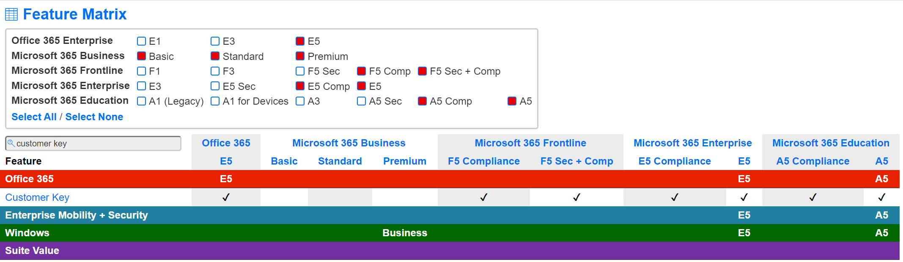
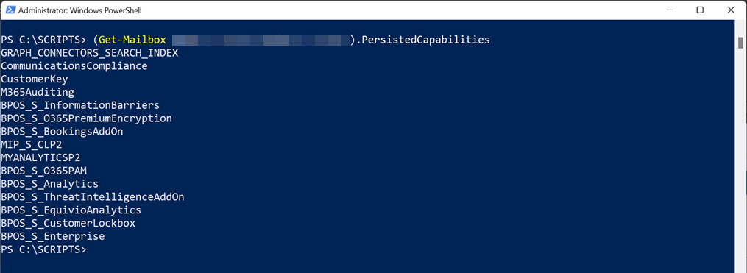
Licensing
https://m365maps.com
Exchange Online Management Shell

Slide 16
Key Management
On-Premises Hardware Service Module (HSM)
Recommended for use in production
Azure Key Vault Key
Recommended for testing or proof-of-concept scenarios
Both options require Azure Key Vault for configuration and management

Slide 17
Microsoft 365 Data-at-Rest
Tenant-wide data protection policy
Teams (stored in Microsoft 365 Group mailbox)
Chat messages (1:1 chats, group chats, meeting chats, channel conversations)
Media messages (images, code examples, video/audio message, wiki pictures)
Chat notifications and chat recommendations by Cortana
Status messages

Slide 18
Microsoft 365 Data-at-Rest
Exchange Online
User and signal information
Mailboxes that do not use a dedicated encryption policy
Microsoft Information Protection
Exact Data Match (EDM) data of sensitive information types
Sensitivity Label

Slide 19
Microsoft 365 Data-at-Rest
Encrypts
New Teams and EDM data after DEP assignment
Exchange Online mailbox content completely

Slide 20
Microsoft 365 Data-at-Rest
Does not encrypt
SharePoint Online and OneDrive
Teams files and recordings in SharePoint Online and OneDrive
Teams Live Event data
Other Microsoft 365 workload data, e.g., Yammer or Planner
Multiple Microsoft 365 Data-at-Rest DEP can exist in a tenant
Only one DEP is actively assigned and tenant-wide in use

Slide 21
Exchange Online
Supported Exchange recipient objects
Mailbox user
Mail user
Microsoft 365 Groups
Shared mailboxes
Public folders
One assigned DEP per object
Maximum of 50 concurrent active DEP per tenant

Slide 22
Exchange Online und Microsoft Teams
Root Keys
2 Customer Keys Azure Key Vault
Availability Key Office 365
RSA
AES 256
Data Encryption Policy Key Based on root keys
AES 256
Mailbox Key
Based on Data Encryption Policy key
AES 256
Mailboxes

Slide 23
SharePoint Online
Encryption of existing files starts right after key assignment
Encrypt content with different keys per Geo-location

Slide 24
SharePoint Online
Root Keys
2 Customer Keys Azure Key Vault
Availability Key Office 365
RSA
AES 256
Tenant Intermediate Key Based on Root-Keys
AES 256
Site Encryption Key Based on Tenant Intermediate Key
AES 256
1 File = N Chunks = N Keys
File Chunk Encrpytion Key
Based on Site Encryption Key
AES 256
Data Chunks

Slide 25
Notes
Loss of customer keys can be mitigated by Microsoft Support
Availability key-based decryption
Reassigning a new DEP with new customer keys
When offboarding from the service you can request the deletion of the Availability key
Data cannot be decrypted, but only deleted

Slide 26
Implementing Purview Customer Key
Implementation 101

Slide 27
Prepare for FastTrack
Create Azure key vaults in two Azure subscriptions
One key vault with one key per workload to encrypt

Slide 28




Prepare for FastTrack
Azure Subscriptions
Subscription A
Subscription B
Key Vaults
KV-M365-A
KV-EXO-A
KV-SPO-A
KV- M365-B
KV-EXO-B
KV-SPO-B
Keys
KEY- M365-A
KEY- EXO-A
KEY- SPO-A
KEY- M365-B
KEY- EXO-B
KEY- SPO-B

Slide 29
Prepare for FastTrack
Azure Subscriptions
Subscription A
Subscription B
Key Vaults
KV-M365-A
KV-EXO-A
KV-SPO-A
KV- M365-B
KV-EXO-B
KV-SPO-B
Keys
KEY- M365-A
KEY- EXO-A
KEY- SPO-A
KEY- M365-B
KEY- EXO-B
KEY- SPO-B
1 Key Pair per workload

Slide 30
Configuration
Create new Azure AD security groups for key vault
Administrator + Contributors
Create two new Azure subscriptions
Separation of Azure resource group, key vault, and key permissions
Use meaningful names, e.g., AZ-EGXDE-CMK-A, AZ-EGXDE-CMK-B
Register your tenant for Customer Key in FastTrack

Slide 31
Configuration
Create a resource group per workload you want to encrypt in each Azure subscription
Create a key vault per resource group
Standard (Test, Proof-of-Concept), or Premium (Production)
Configuration of access permissions per key vault using previously created security groups
Create keys in key vault

Slide 32
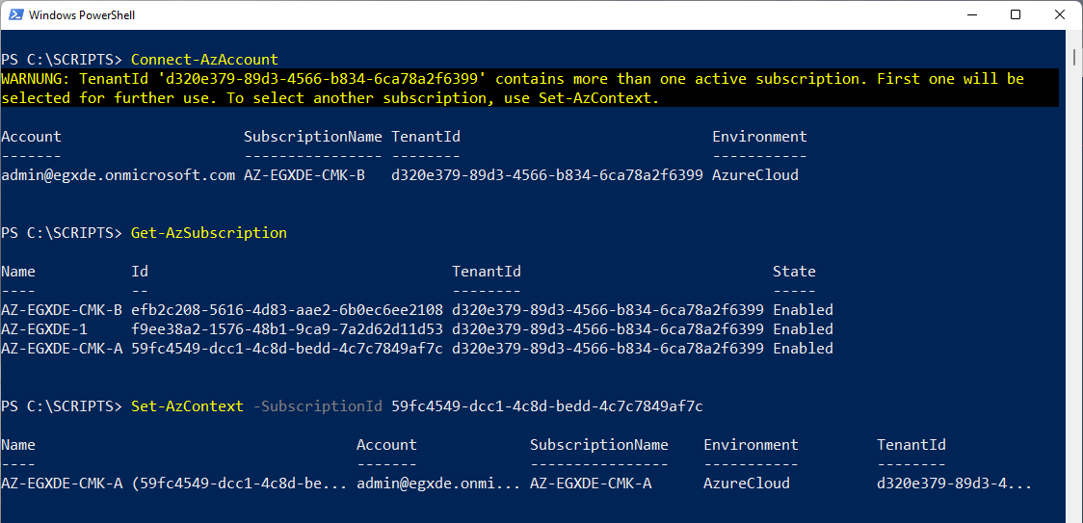
Configuration

Slide 33
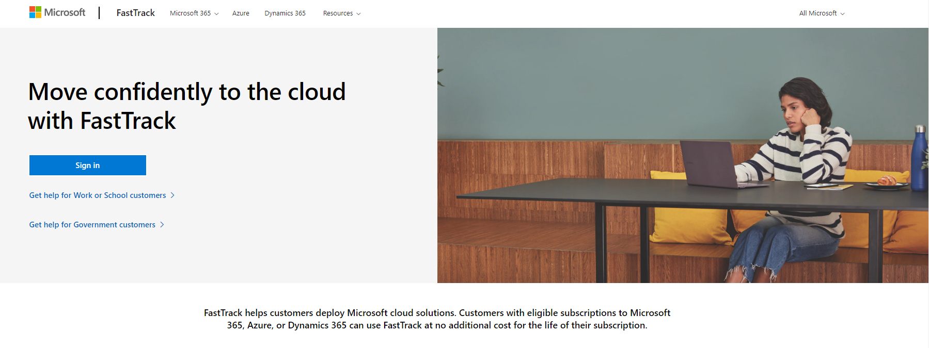
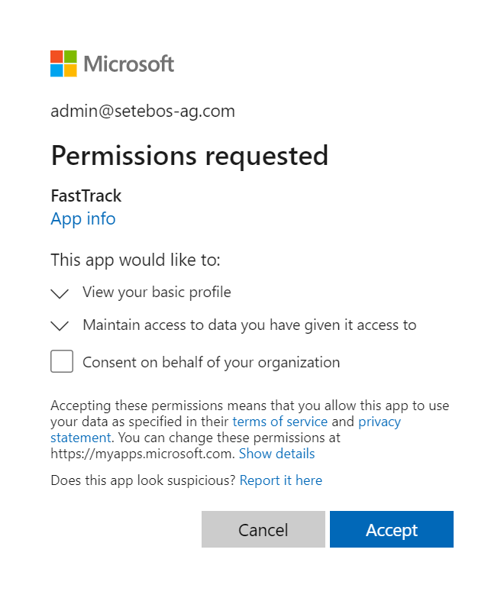
FastTrack
https://fasttrack.microsoft.com

Slide 34
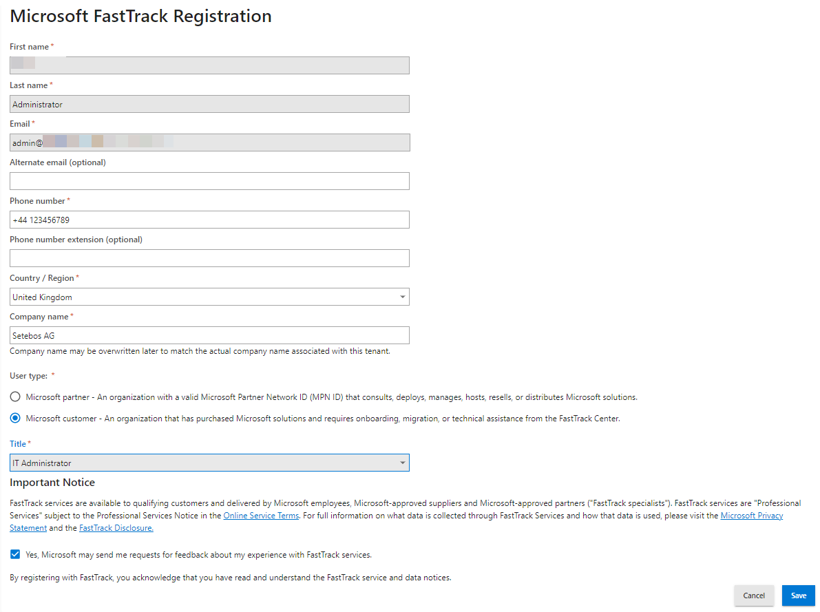
FastTrack

Slide 35
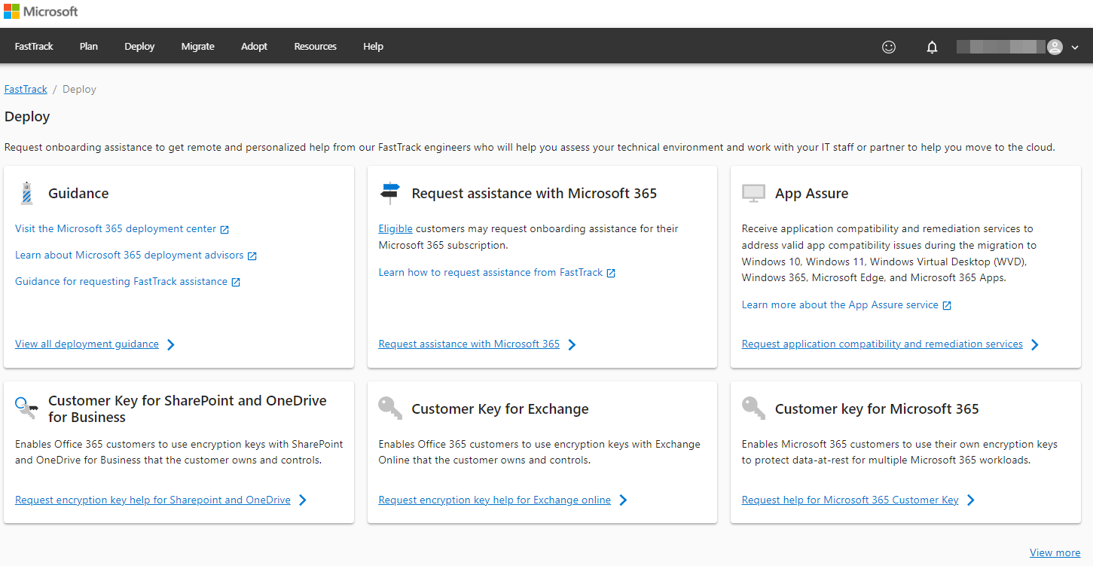
FastTrack

Slide 36
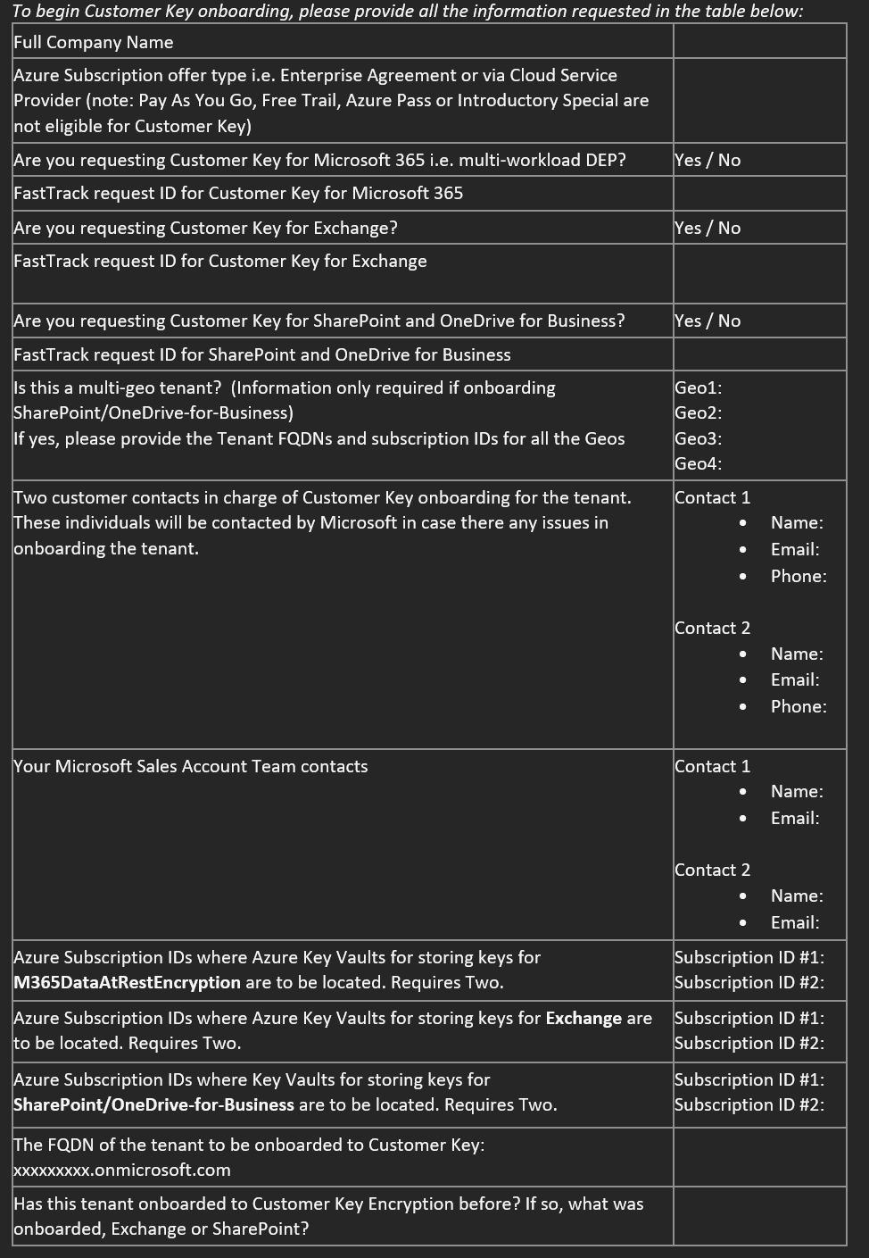
FastTrack

Slide 37
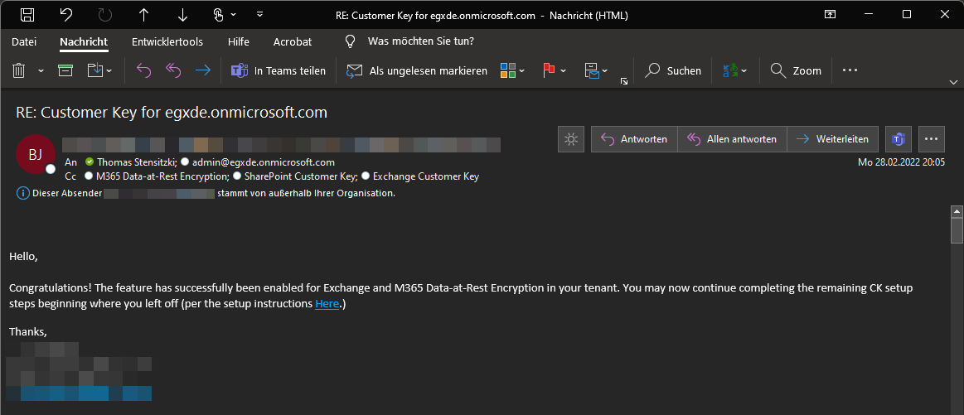
FastTrack

Slide 38
Data Encryption Policies
Use your Purview Customer Keys

Slide 39
Data Encryption Policy Management
Microsoft 365 Data-at-Rest and Exchange Online
→ Exchange Online Management v2 PowerShell Module
SharePoint Online
→ SharePoint Online PowerShell Module

Slide 40
Multi-Workload
$key1 = 'https://az-kv-egxde-m365dr-a.vault.azure.net:443/keys/egxde-m365dr-key-a'
$key2 = 'https://az-kv-egxde-m365dr-b.vault.azure.net:443/keys/egxde-m365dr-key-b'
# Create new multi-workload data encryption policy
New-M365DataAtRestEncryptionPolicy -Name 'EGX_DataAtRest' `
-AzureKeyIDs $key1,$key2 -Description 'EGX Data at Rest Multi-Workload policy'
# Assign multi-workload data encryption policy at tenant level
Set-M365DataAtRestEncryptionPolicyAssignment `
-DataEncryptionPolicy 'EGX_DataAtRest'

Slide 41
Multi-Workload
Get-M365DataAtRestEncryptionPolicyAssignment | fl
IsDeleted : False
Rdn : CN=EGX_DataAtRest
Parent : egxde.onmicrosoft.com\CKaaS Data Encryption Policies
DistinguishedName : CN=EGX_DataAtRest,CN=CKaaS Data Encryption Policies,CN=Configuration,CN=egxde.onmicrosoft.com,CN=ConfigurationUnits,DC=DEUP281A001,DC=PROD,DC=OUTLOOK,DC=COM
IsRelativeDn : False
Name : EGX_DataAtRest

Slide 42
Exchange Online
# Set encryption key URI variables
$key1 = 'https://az-kv-egxde-exo-a.vault.azure.net:443/keys/egxde-exo-key-a'
$key2 = 'https://az-kv-egxde-exo-b.vault.azure.net:443/keys/egxde-exo-key-b'
# Create new Exchange Online data encryption policy
New-DataEncryptionPolicy -Name 'EGX_EXO_DEP' `
-AzureKeyIDs $key1,$key2 `
-Description 'EGX Exchange Online Encryption Policy'

Slide 43
Exchange Online
# Assign Exchange Online DEP to different objects
Set-Mailbox LouisR@varunagroup.de -DataEncryptionPolicy 'EGX_EXO_DEP'
Set-Mailbox LouisR@varunagroup.de -DataEncryptionPolicy 'EGX_EXO_DEP' -PublicFolder
Set-MailUser OnPremUser@varunagroup.de -DataEncryptionPolicy 'EGX_EXO_DEP'
Set-UnifiedGroup SomeGroup@groups.varunagroup.de -DataEncryptionPolicy 'EGX_EXO_DEP'
# Verification for mailbox user
Get-MailboxStatistics USERUPN | FL IsEncrypted

Slide 44
SharePoint Online
# PowerShell Module: Microsoft.Online.SharePoint.PowerShell
Connect-SPOService -Url https://tenant-admin.sharepoint.com
# Query Azure key vault key versions
Set-AzContext –SubscriptionId SUBSCRIPTION-A
$key1version = (Get-AzKeyVaultKey -VaultName az-kv-egxde-spo-a ` -Name egxde-spo-key-a -IncludeVersions).Version
Set-AzContext –SubscriptionId SUBSCRIPTION-B
$key2version = (Get-AzKeyVaultKey -VaultName az-kv-egxde-spo-b ` -Name egxde-spo-key-b -IncludeVersions).Version

Slide 45
SharePoint Online
# Create SharePoint Online data encryption policy
Register-SPODataEncryptionPolicy ` -PrimaryKeyVaultName 'az-kv-egxde-spo-a' -PrimaryKeyName 'egxde-spo-key-a' ` -PrimaryKeyVersion $key1version ` -SecondaryKeyVaultName 'az-kv-egxde-spo-b' -SecondaryKeyName 'egxde-spo-key-b' ` -SecondaryKeyVersion $key2version
# Verify encryption policy
Get-SPODataEncryptionPolicy

Slide 46

Thank You
Thomas Stensitzki
MVP M365 Apps & Services
CEO @ GRANIKOS
Thomas.Stensitzki@Granikos.eu
Twitter: @Stensitzki
MVP: https://bit.ly/3qxCI7t

Slide 47
Resources
Get started with exact data match based sensitive information types
Understanding Microsoft Information Protection Encryption Key Types
Roll or rotate a Customer Key or an availability key
Move requests in the Microsoft 365 or Office 365 service
Encryption ciphers used by Customer Key
Encryption for Skype for Business, OneDrive for Business, SharePoint Online, Microsoft Teams, and Exchange Online

Slide 48
Resources
Microsoft 365 Multi-Geo eDiscovery configuration
Microsoft 365 encryption technical reference
Assign roles in Azure Portal
Microsoft 365 Maps
Double Key Encryption

